Slide 1
Development of Dashboard for Test

Slide 2
Problem
At present, parsing & documenting of the test output logs [present either on the console or on text file] generated by executing the test scenarios [present in csv files] involve considerable amount of engineer effort.
Also to view test input/output [could be an image or some values depending on the algorithm] information, one has to login to the machine where the test is executed.

Slide 3
Objective of project
To develop a dashboard which merges the test input parameter information, respective test output log along with displaying of test input/output images will be of great help to the developer(s) saving his time.
Give a visual effect (html front end) so that this shall be used as Test Result Report.

Slide 4
Dashboard
The dashboard serves the purpose of displaying details such as kernel execution time, total time etc. on executing certain algorithms over several images and drawing a comparison between different test environment types.
The python program takes as input a csv file, its corresponding log file, median value files (if any) and path to the images which can be viewed in the dashboard.

Slide 5
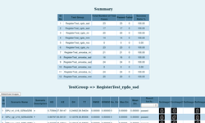
Solution
CSV FILE
TESTING DASHBOARD Script
LOG FILE

Slide 6
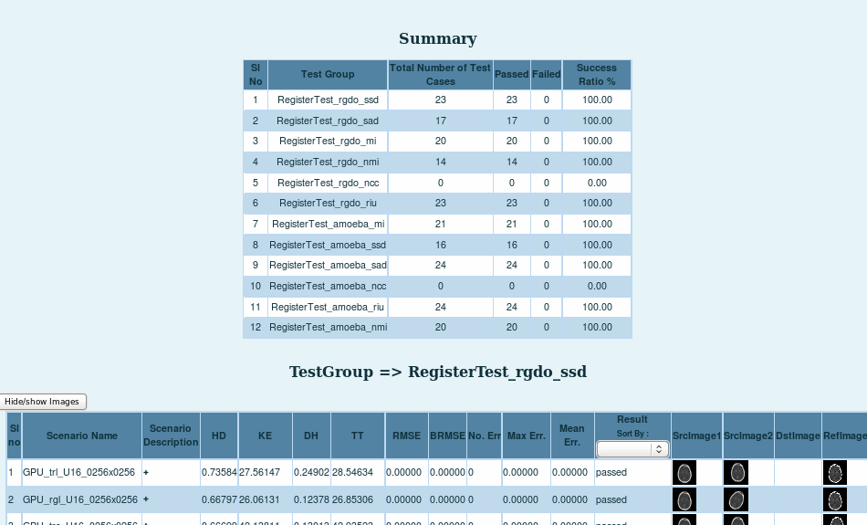
Solution (contd)

Slide 7
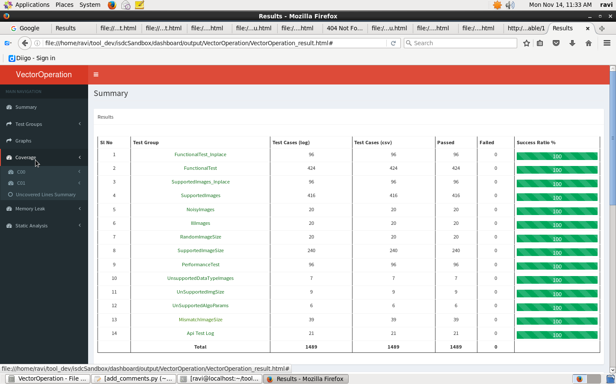
Screenshots

Slide 8
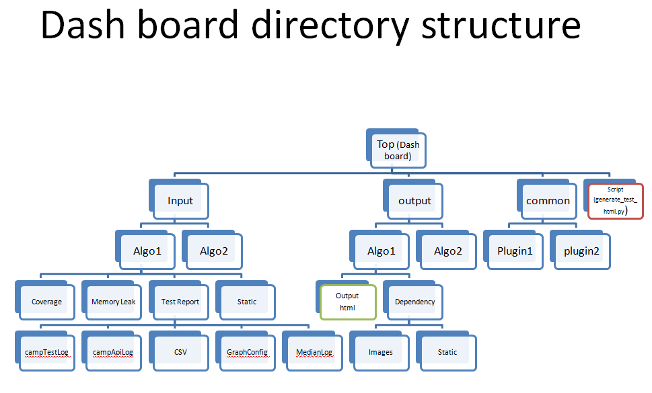

Slide 9
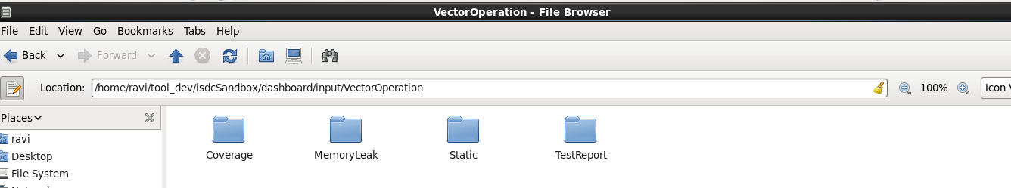
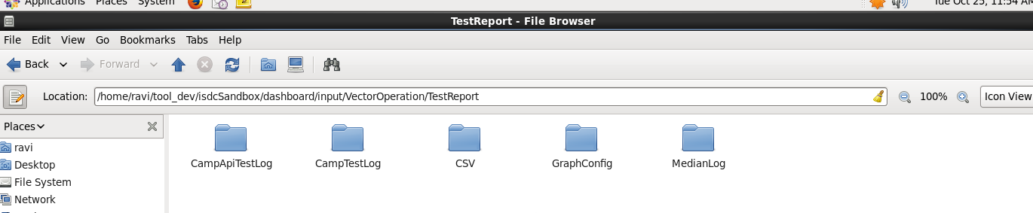
Directory Structure

Slide 10
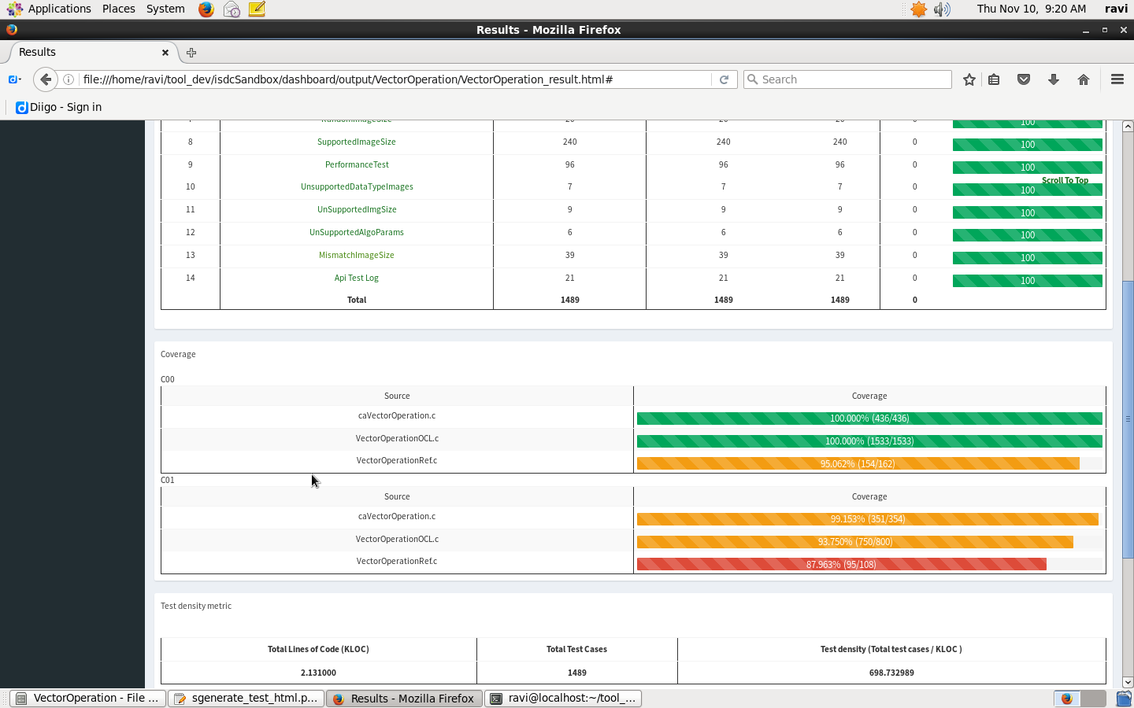
Screenshots

Slide 11
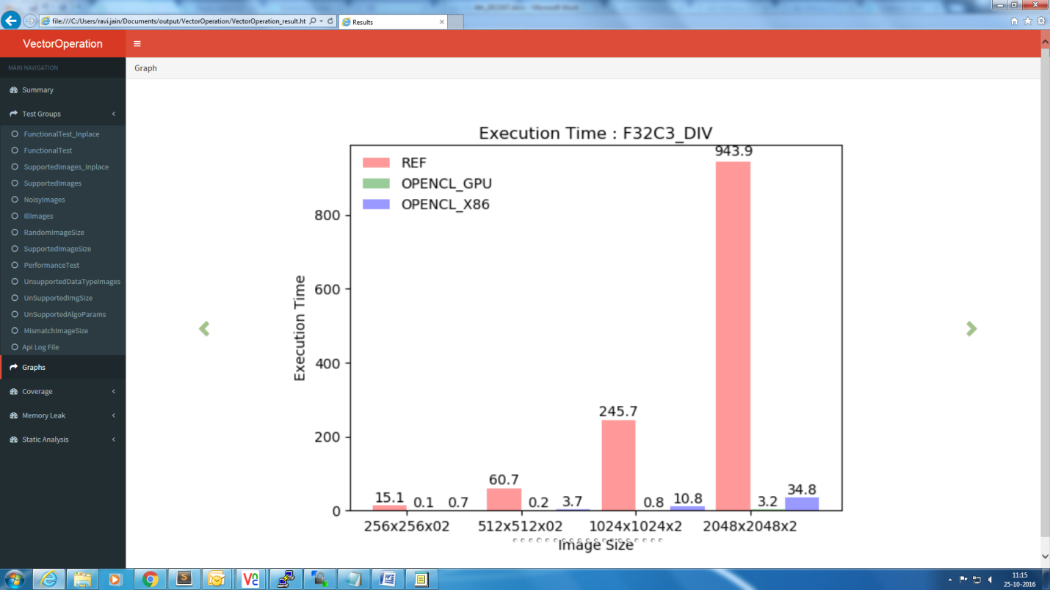
Screenshots

Slide 12
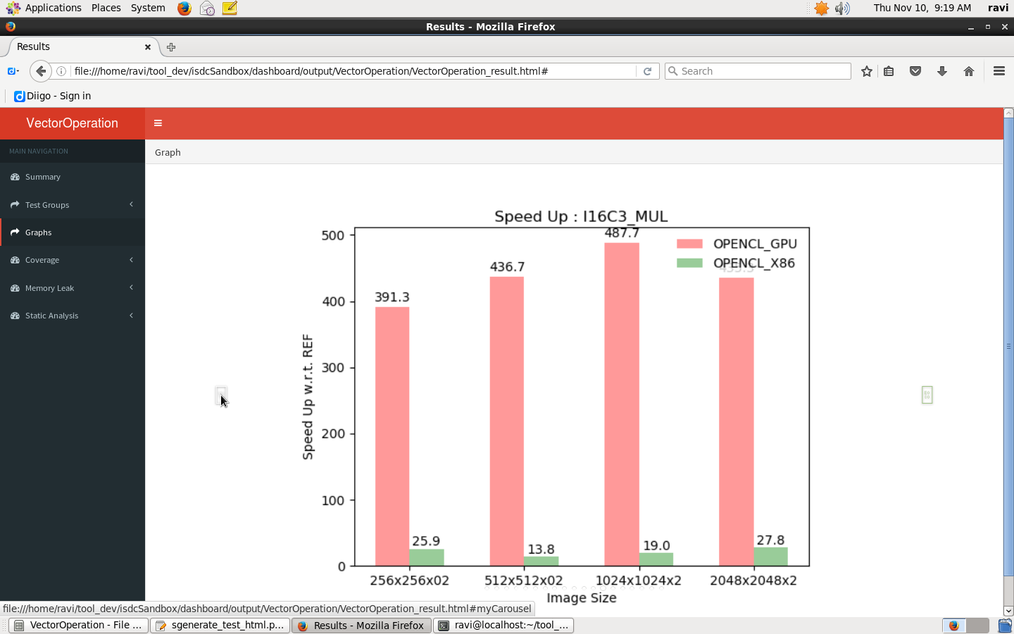
Screenshots

Slide 13
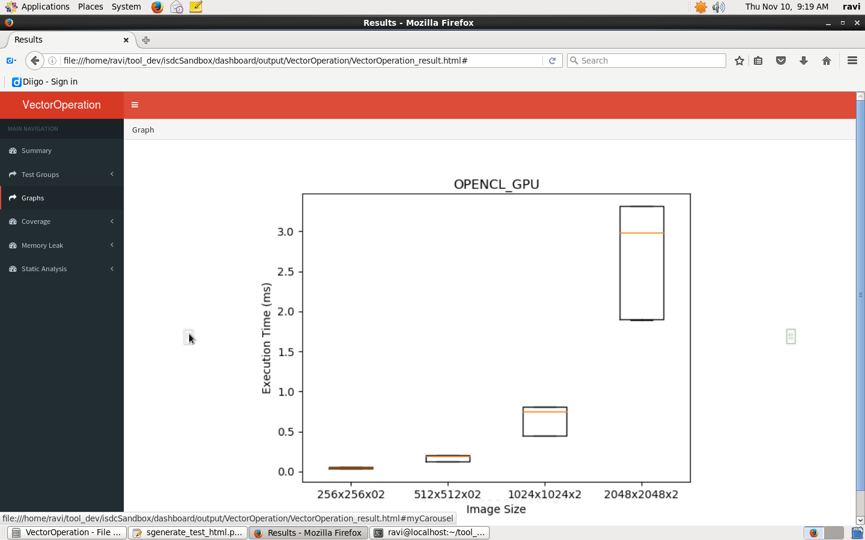
Screenshots

Slide 14
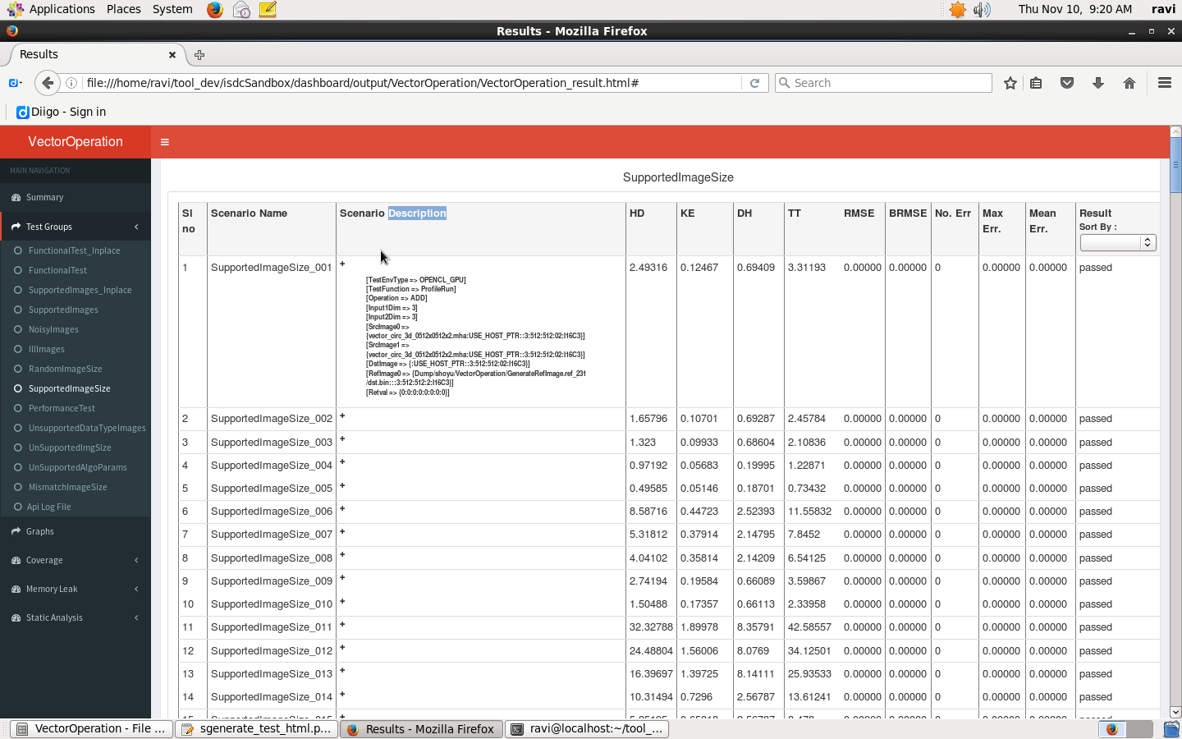
Screenshots

Slide 15
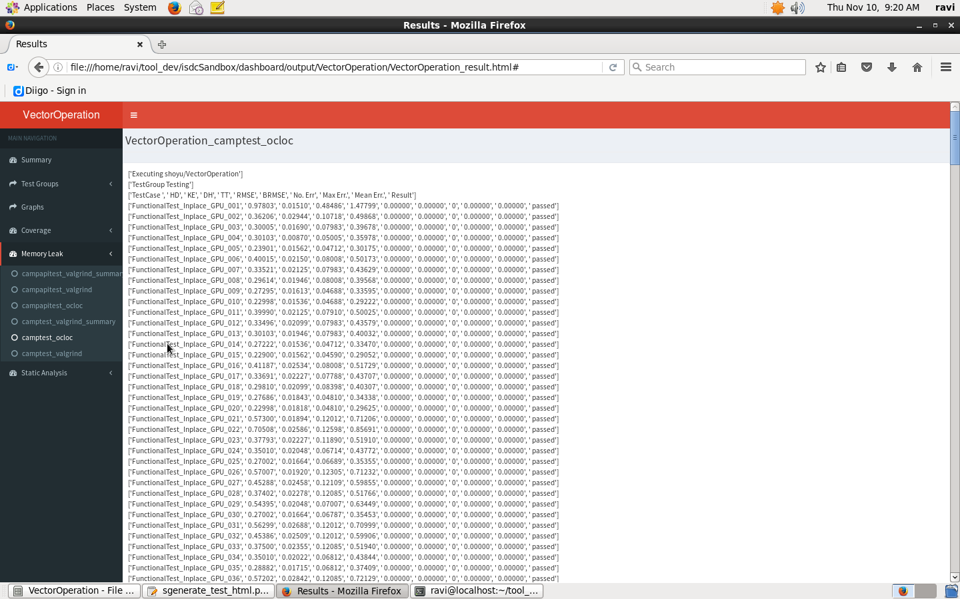
Screenshots

Slide 16
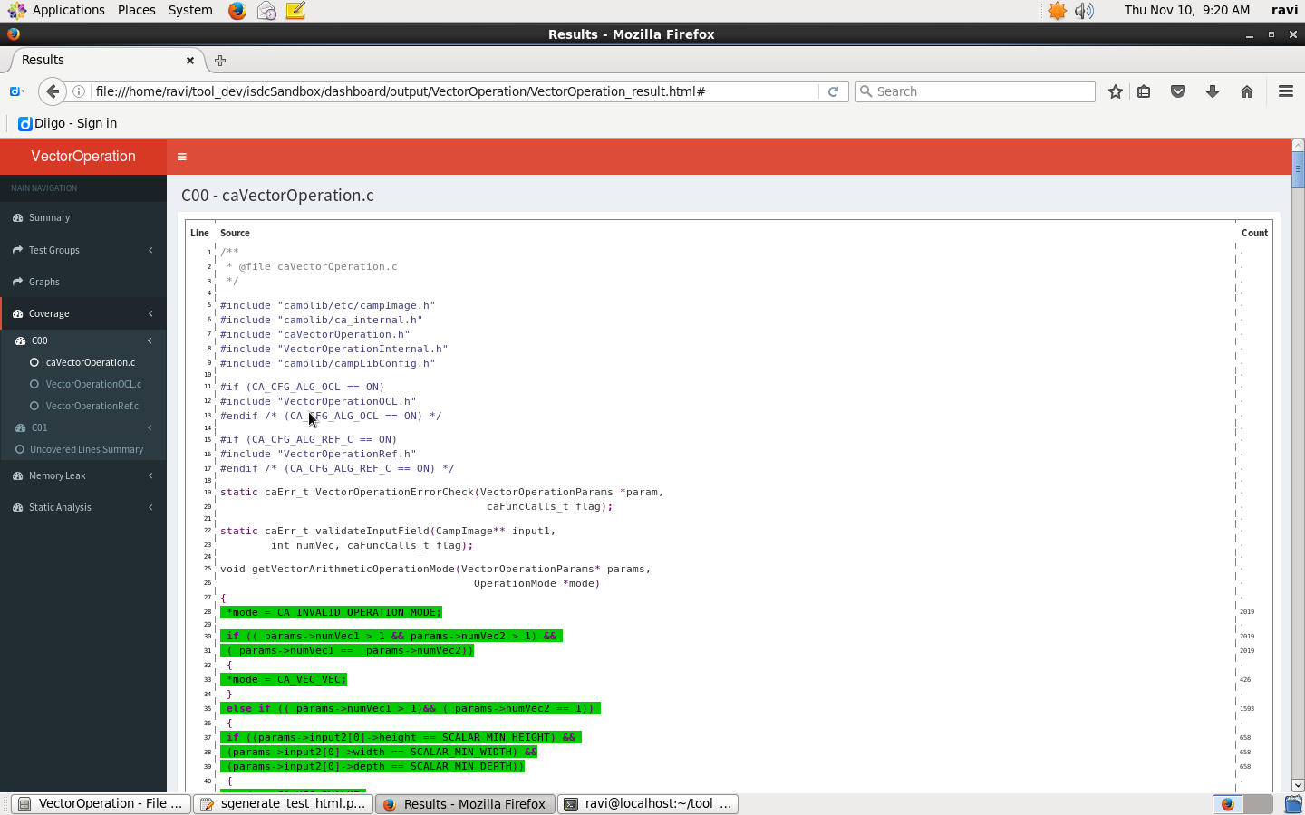
Screenshots

Slide 17
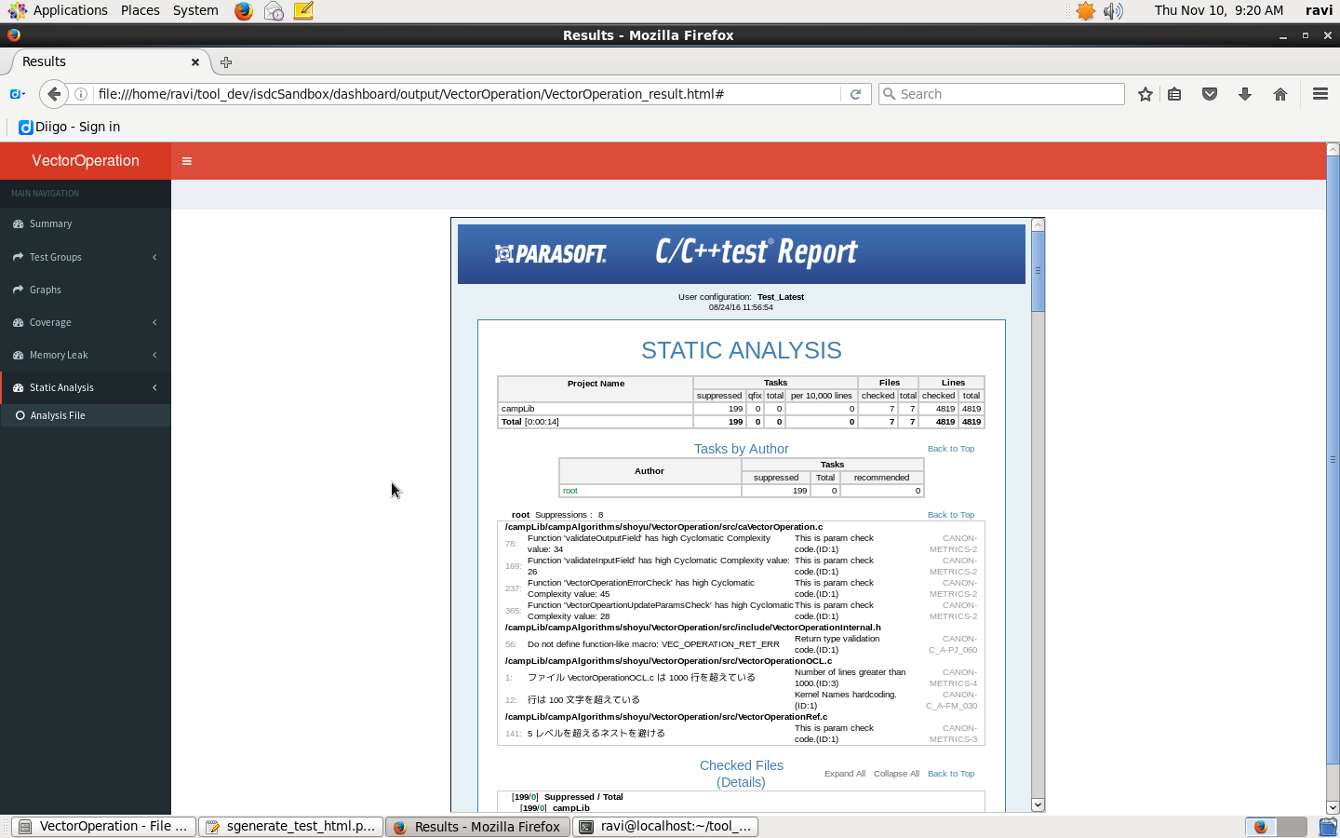
Screenshots

Slide 18
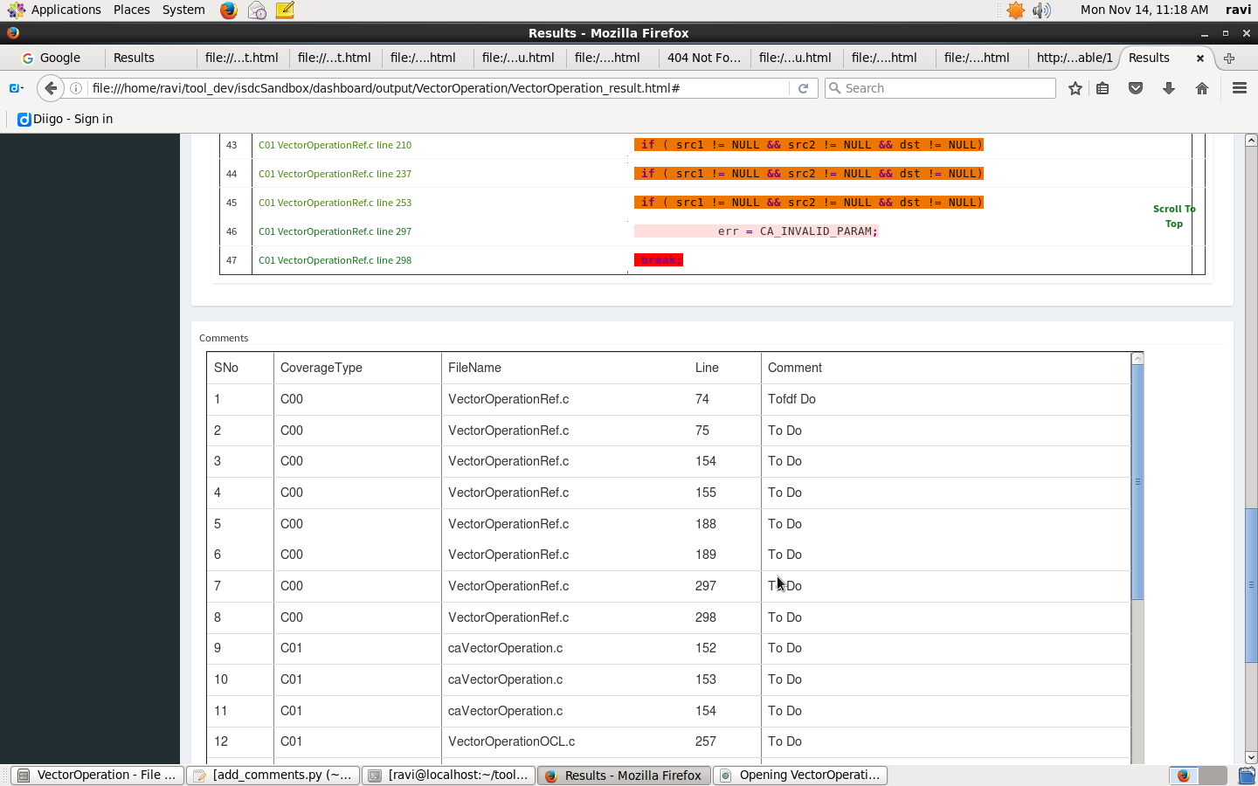
Screenshots

Slide 19
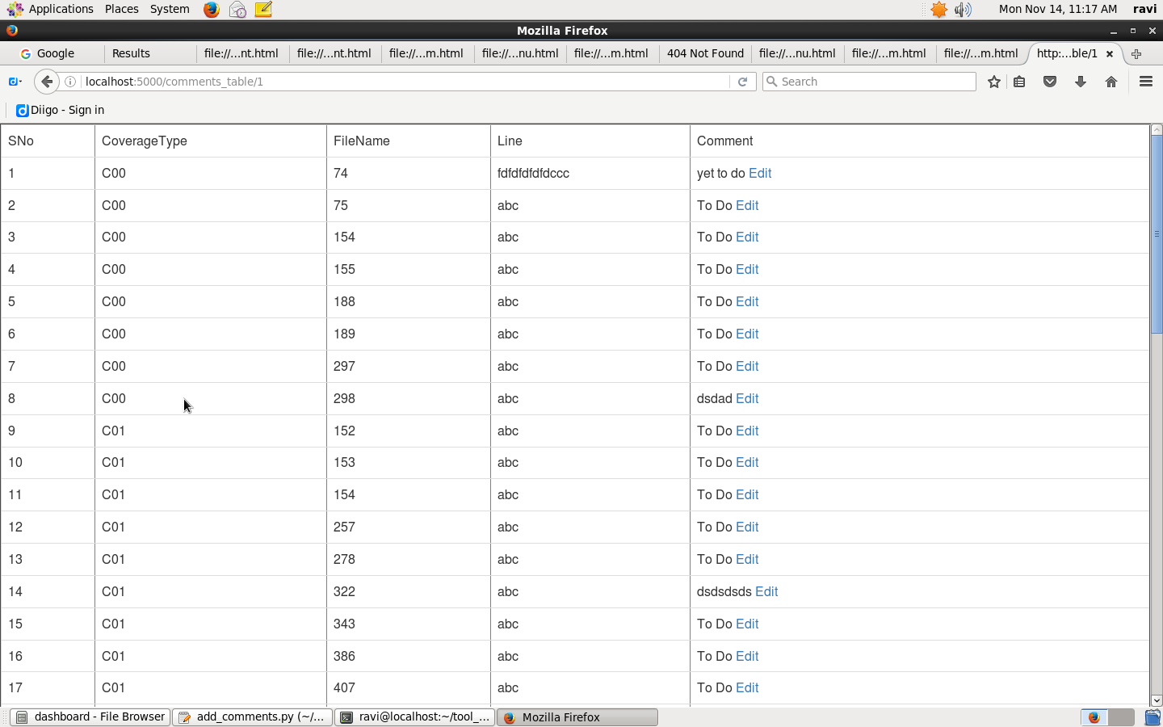
Screenshots

Slide 20
Software requirement
System must have python >=2.7
Use command scl enable python27 bash to enable python 2.7
Packages required are BeautifulSoup4, matplotlib
In order to install these packages use pip install package_name or go to https://pypi.python.org/pypi and search for the required packages
After downloading a package, go to the folder with downloaded content and run python setup.py install

Slide 21
Command line arguments
General argument to display all content for an algorithm after folder structure is maintained -
python generate_test_html.py –al algo_name
For example : python generate_test_html.py –al VectorNorm
To display specific contents use –co, -tr, -ml and –st for coverage, test report, memory leak and status analysis files respectively.
Example : python generate_test_html.py –al VectorNorm –tr –co
Kindly maintain folder structure before running the program.

Slide 22
Tools used
Python (2.7)
HTML & CSS
AngularJS (1.3.14)
Bootstrap
Jquery
Javascript
AdminLTE-2.3.6 dashboard skins

Slide 23
Further Improvements
Using server-client set up and a database, better comments page can be created.
Python flask framework can be deployed.
Improvements can be made for reducing the time taken by program to generate this page.

Slide 24
Conclusion
The developed utility provided simple and easy to understand front end for parsing the generated test results. Automated the entire post processing activity related with test results capturing.
In future, this shall be integrated with jenkins

Slide 25
Reference Links
https://almsaeedstudio.com/
https://jquery.com/
https://angularjs.org/
www.w3schools.com

